Slide 1
Technical Writing Gillian saunders The Centre for Academic Communication Feb 5, 2018

Slide 2
Overview
What is technical writing?
Tips for achieving clarity
How the CAC can help you

Slide 3
What is Technical Writing?
Topic:
products and services
Purpose:
to explain, advise, instruct
Style and Tone:
objective, clear, straightforward, short and concise sentences and paragraphs
Examples:
memos, emails, instruction manuals, websites, reports

Slide 4
What Technical Writing ISN’T
An Essay
No lengthy introduction, conclusion, explanations, analysis, or transitions
An argument or opinion
None of your own beliefs or opinions
Poetry
No flowery language or “interesting” words. Leave the thesaurus out of it, and use denotative language.
Notes:
Except, for transitions, you’ll need to illustrate next steps, or the order that information or actions are to be processed.

Slide 5
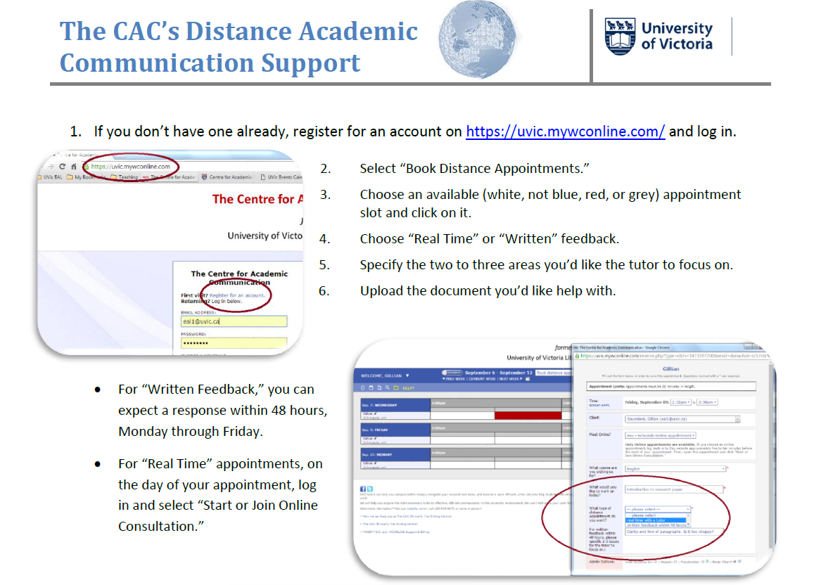

Slide 6
Why Is It Important to Write Well?
“A study by the National Commission on Writing found that 64 of the largest U.S. corporations, employing close to eight million people, spend as much as $3.1 billion annually to follow up on the poor writing skills of employees.”
– Vancouver Sun (2012)

Slide 7
Tips for Achieving Clarity
Know your audience
How much do they already know?
Define key terms
Provide context
BUT do not over-explain
How will they consume your text?
What do you want them to get out of it?

Slide 8
Paragraph Structure
MAIN IDEA
Topic Sentence
Explain Causes
Supporting Sentences
Give Examples
Supporting Sentences
Define Terms
Compare
Provide statistics
Use Analogy
Analyze
Concluding Sentence

Slide 9
Tips for Achieving Clarity
Use exact numbers and other information when possible
A few → three
Some → between four and six
During business hours → from 9am to 5pm, PST, Monday through Friday

Slide 10
Tips for Achieving Clarity
Use consistent wording
Prefer clarity over variety
If you’re referring to a “screen”; do not switch to “monitor” halfway through

Slide 11
Tips for Achieving Clarity
Be brief (and on screen, be even briefer)
Use active voice and avoid passive constructions
Avoid excessive wordiness
Use short sentences (15 to 20 words, max) and short paragraphs (5 to 8 sentences, max)
→ ~100 words per paragraph

Slide 12
Tips for Achieving Clarity
Pay attention to organization and layout
Use headings and subheadings to organize topics
Use bullet points or numbered lists when appropriate

Slide 13
Clarity and Consistency in Headings: Parallelism
Navigating Change
Creating urgency
Build a guiding coalition
Developing a vision of change
Communicating the vision
Empower actions
Celebrate short-term wins
Incorporating changes into culture
Navigating Change
Create urgency
Build a guiding coalition
Develop a vision of change
Communicate the vision
Empower actions
Celebrate short-term wins
Incorporate changes into culture
Notes:
Still from the same MBA student

Slide 14
Tips for Achieving Clarity
Pay attention to organization and layout
Use headings and subheadings to organize topics
Use bullet points or numbered lists when appropriate
Use graphs, charts, or diagrams
Make key content as easy as possible to find
Facilitate selective reading

Slide 15
Final Thoughts
Ask yourself, “Do my readers *need* this information (in order to do what I want them to know/be able to do)?”
Answer questions as they will arise in readers’ minds

Slide 16
How Can the CAC Help?
1:1 tutorials, 10 to 4, Monday to Friday
25 minutes, up to 10 per term
Bookable in advance on uvic.mywconline.com
“Express” help, 4 to 5pm, Tuesday to Thursday
15 minutes, drop in to sign up, quick questions

Slide 17
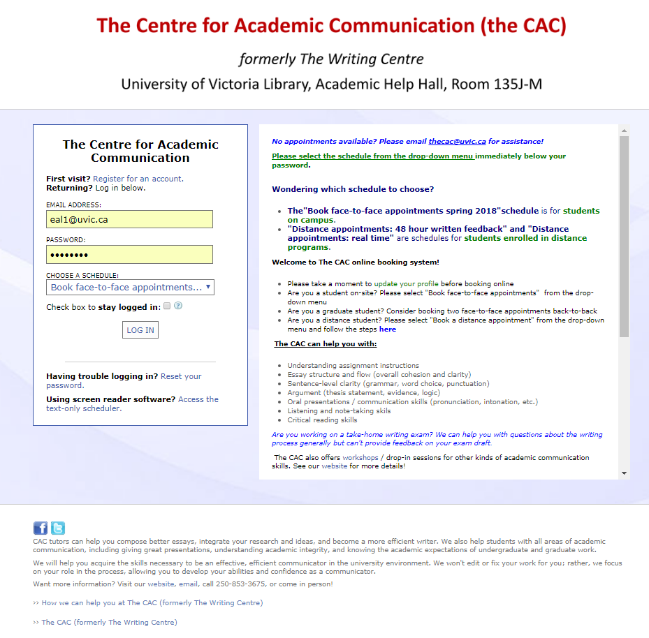

Slide 18
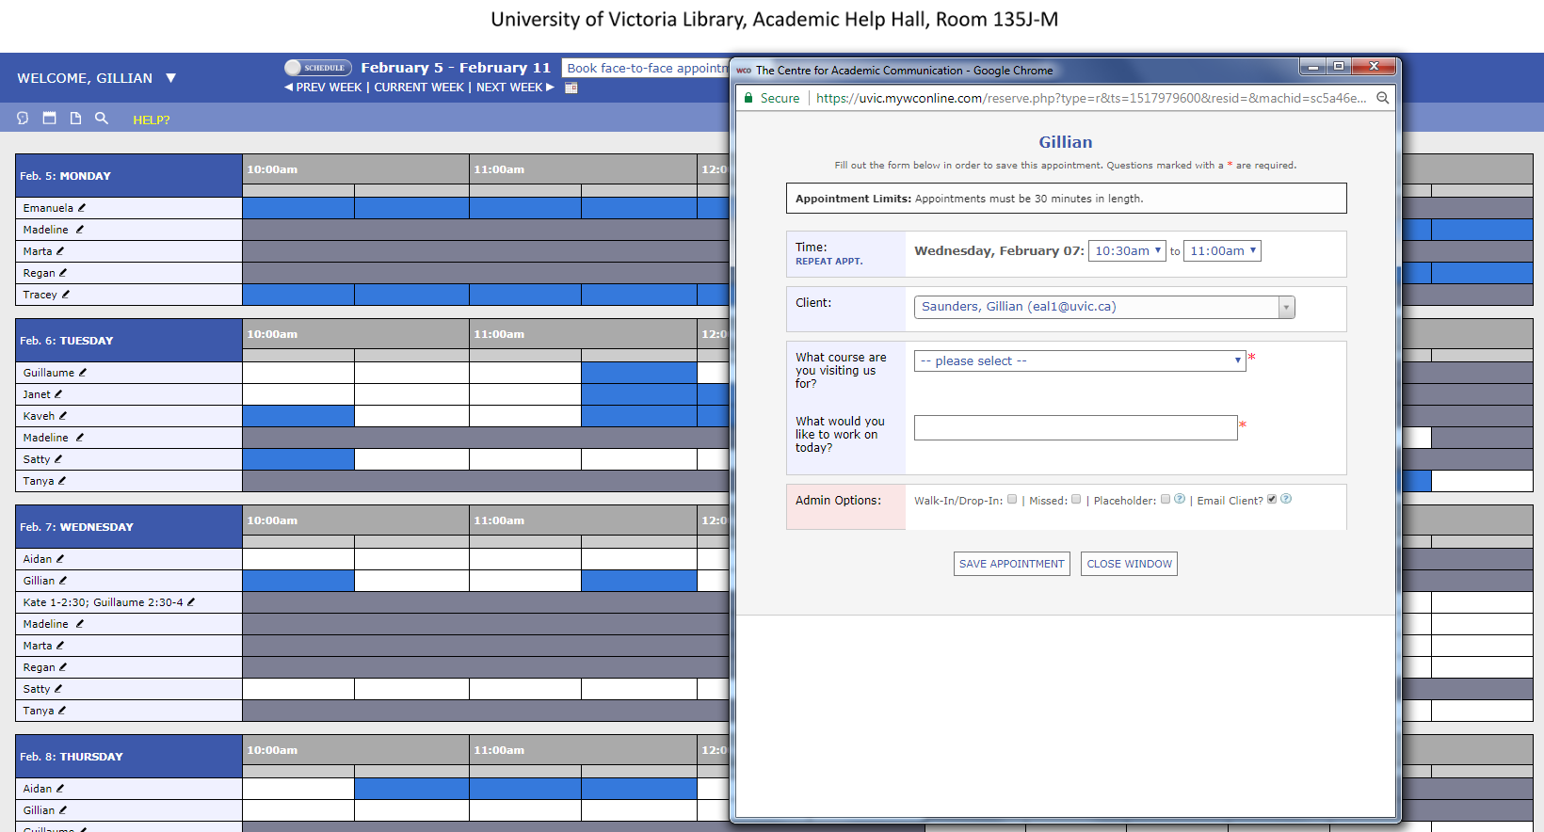

Slide 19
How Can the CAC Help?
1:1 tutorials, 10 to 4, Monday to Friday
25 minutes, up to 10 per term
Bookable in advance on uvic.mywconline.com
“Express” help, 4 to 5pm, Tuesday to Thursday
15 minutes, drop in to sign up, quick questions
Workshops:
Vocabulary Building Strategies (Feb 6, 2:30)
Academic Language and Tone (Feb 20, 2:30)
Scientific Writing (March 6, 2:30)
Library 151b or 130

Slide 20
Any Questions?

